Slide 1

Open API
Dima Ionut Daniel

Slide 2
Contents
What is Open API?
Goals
Spring and Open API
Core
Migrating from SpringFox
Conclussion
Bibliography

Slide 3

What is Open API ?
OpenAPI is a specification for a machine-readable interface definition language.
It's used for describing, producing and visualizing RESTful web services.
Previously part of the Swagger framework, it became a separate project in 2016.

Slide 4
Goals
API contract: establish a contract to ensure that API are reusable and consistent
Centralization: create a central point to enforce the API
Reusability: incorporates reusable components into design
Versioning: Helps to keep track off all versions of the API
API discovery: provides the means to easily search for and discover APIs that are deployed
Tracking: keeps track of where the API are being used, who is using them, and how they’re using them.
Automation: automate the processes for API contracts, documentation, and tracking.
Deprecation policy: establish a deprecation policy to guide developers and keep control of various versions of an API.

Slide 5
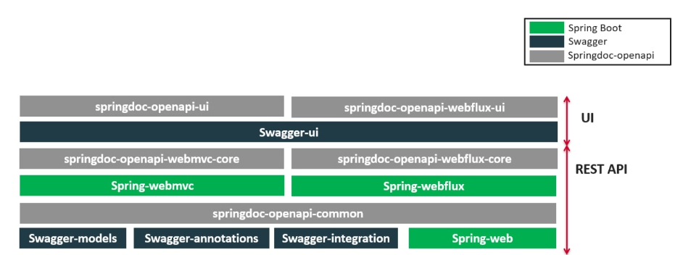
Spring and Open API
General overview

Slide 6
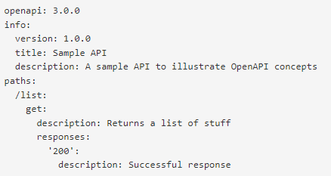
Core
From version Open API 3.0, definitions can be written in JSON or YAML.
YAML format is recommended as it's easier to read and write.

Slide 7
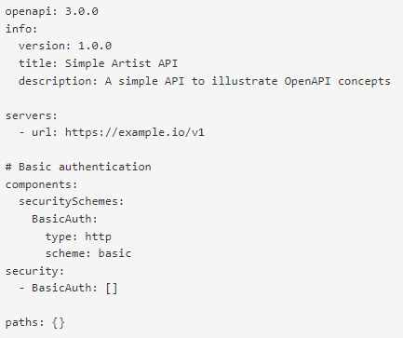
Core (cont.)
Each API definition starts with the version of the Open API specification.
The info object contains required fields like title and version, and an optional description.
The servers array specifies on or more server URLs.

Slide 8
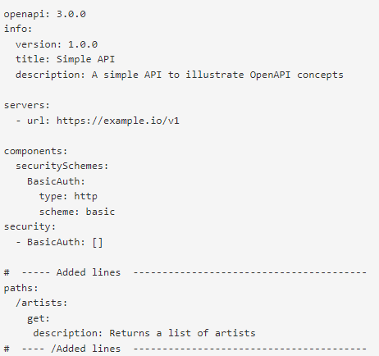
Core (cont.)
The path items are the endpoints of the API under which we are performing the CRUD REST actions.
These endpoints are relative to the server URL.

Slide 9
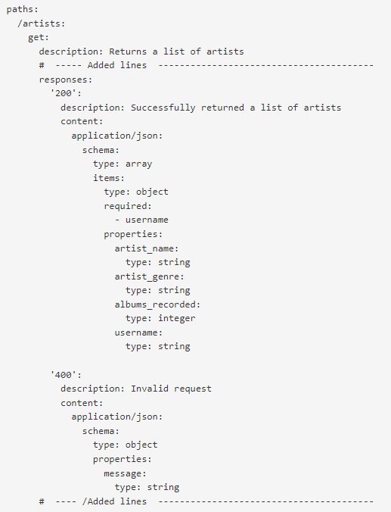
Core (cont.)
Every response needs at least one HTTP status code to describe the kind of responses a consumer is likely to expect followed by a one or no payload.

Slide 10
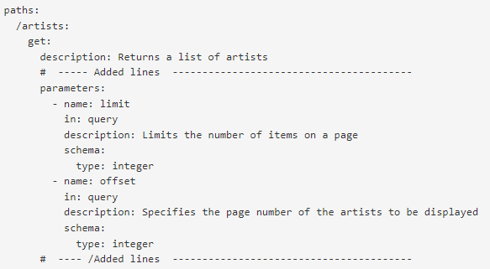
Core (cont.)
Query parameters specify the variables part of the resource.
Example for GET https://example.io/v1/artists?limit=20&offset=3

Slide 11
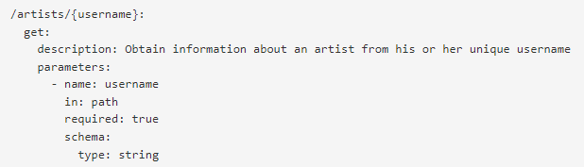
Core (cont.)
Path parameters can be used to isolate a specific component of the data.
Example: https://example.io/v1/artists/{username}

Slide 12
Core (cont.)
Most used v3 annotations:
@Operation: describes a single API operation on a path
@APIResponse: describes the endpoint’s response
@OpenAPIDefinition: root document object of the OpenAPI document
@Parameter: the name of the method parameter
@Schema: allows the definition of input and output data types
@Tag: used to add tags to the REST endpoint contract

Slide 13
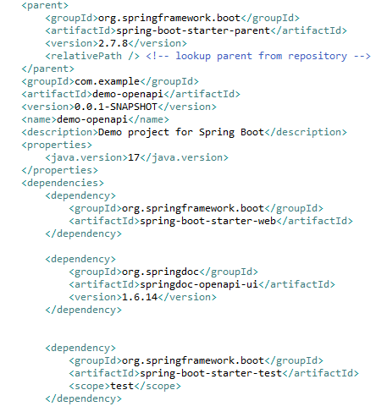
Core (cont.)
We’ll create a Spring Boot 2.7.8 application with Open API 3.0 Swager.
Spring Boot 3 or above will not work since SpringFox project was abandoned.
Bellow is an example of the pom.xml containing the springdoc-openapi-ui dependency.

Slide 14
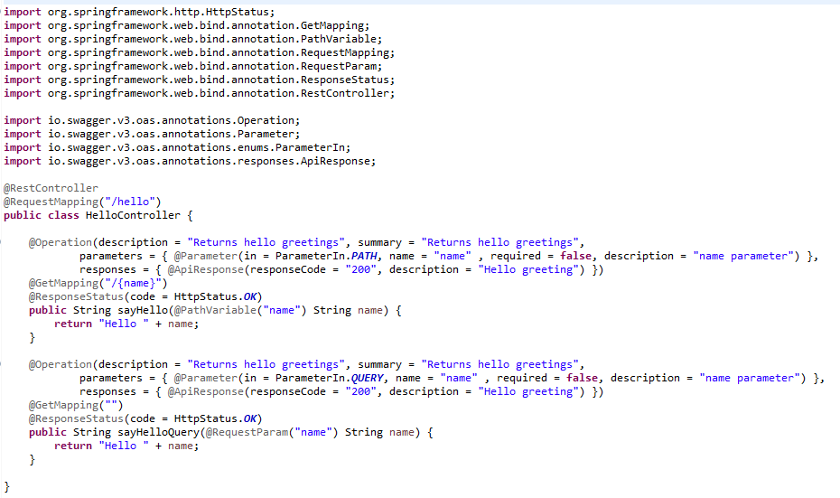
Core (cont.)
The Hello REST controller looks like:

Slide 15
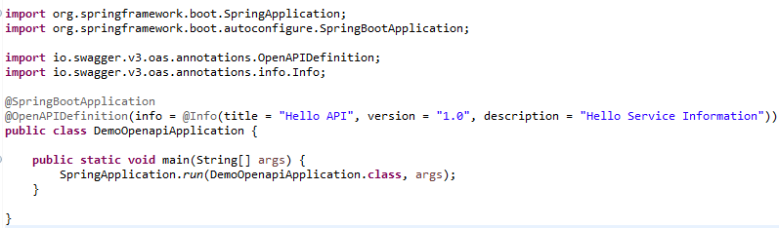
Core (cont.)
The SpringBoot Application startup class looks like:

Slide 16
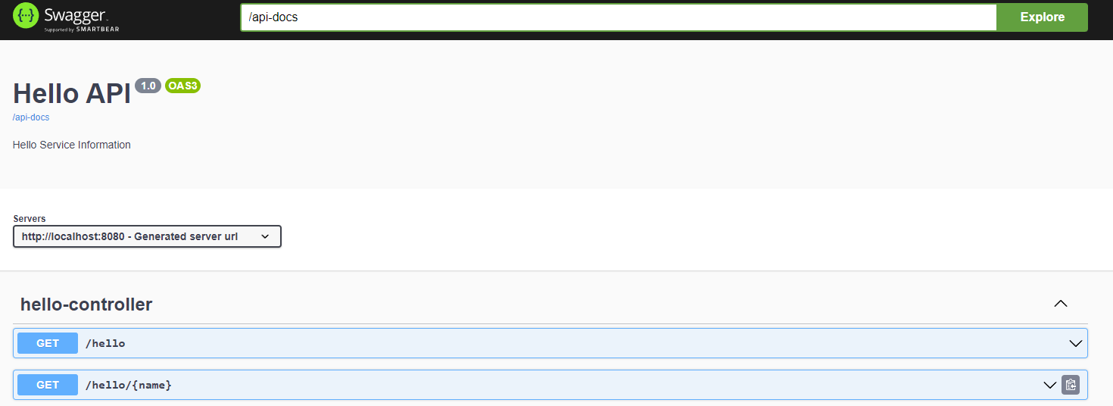
Core (cont.)
We can access Swagger-UI by accessing http://localhost:8080/swagger-ui/index.html URL.

Slide 17
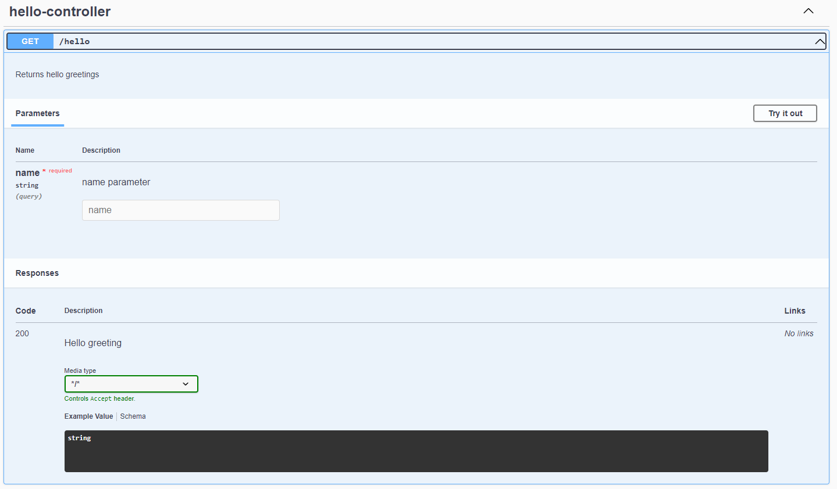
Core (cont.)
We can expand the operations operation info and check for more details or even call the service by pressing the “Try it out” button, filling the data and click the “Execute” button.

Slide 18
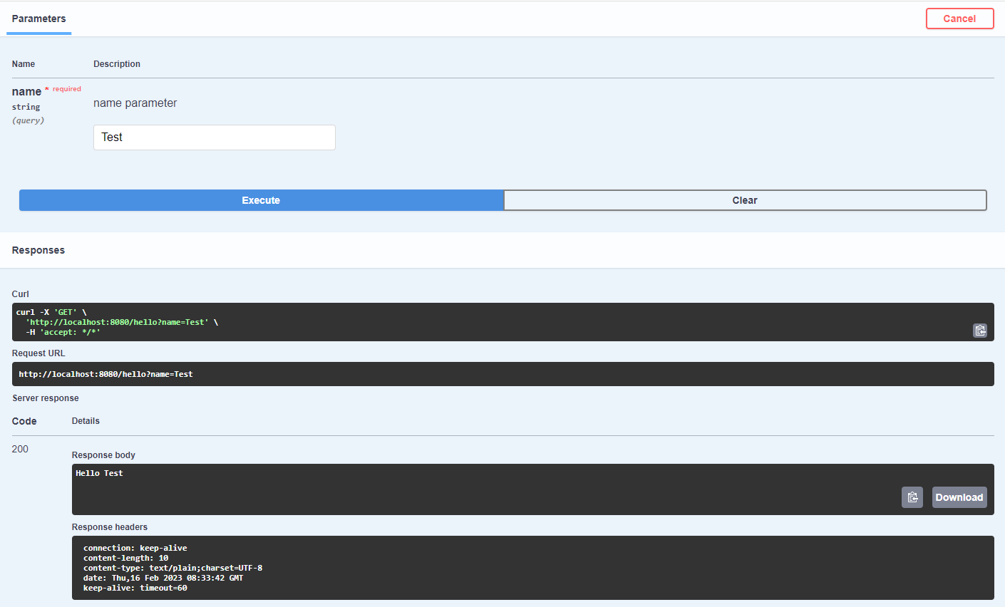
Core (cont.)
Sample of invoking the controller by using the Swagger-UI.

Slide 19
Core (cont.)
By default the descriptor is generated via http://localhost:8080/v3/api-docs in JSON format and can be overridden by the property springdoc.api-docs.path defined into the application.properties .
Example: springdoc.api-docs.path=/api-docs
All the properties are described on https://springdoc.org/properties.html

Slide 20
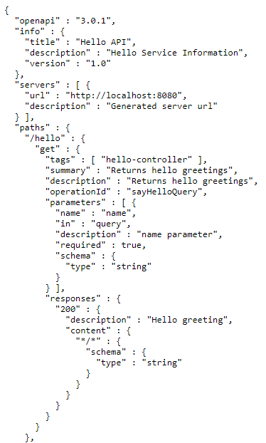
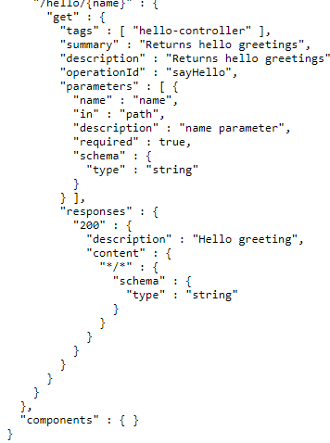
Core (cont.)
To obtain the service description in JSON format we access http://localhost:8080/v3/api-docs
“springdoc.writer-with-default-pretty-printer” property can be set to true to pretty format the JSON

Slide 21
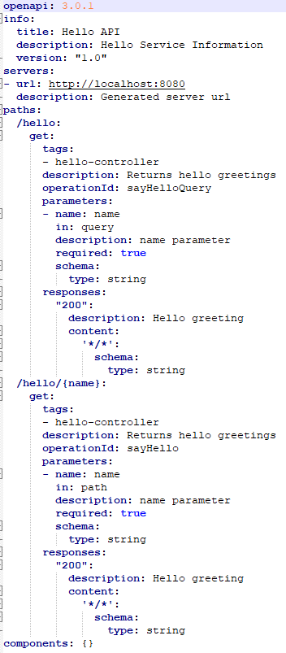
Core (cont.)
For YAML: http://localhost:8080/v3/api-docs.yml

Slide 22
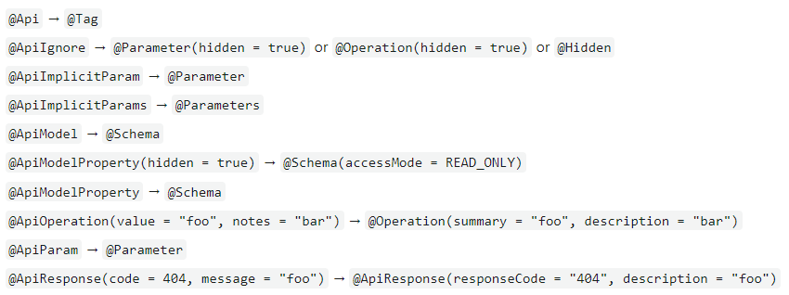
Migrating from SpringFox
To migrate we need:
Remove springfox and swagger 2 dependencies
Add springdoc-openapi-ui dependency
Replace swagger 2 annotations with swagger 3 annotations

Slide 23
Conclussion
Pros:
Low cost to expose an REST API
It’s open-source
Easy to implement
Truly integrates workflows

Slide 24

Bibliography
https://www.openapis.org/
https://en.wikipedia.org/wiki/OpenAPI_Specification
https://support.smartbear.com/swaggerhub/docs/tutorials/openapi-3-tutorial.html
https://springdoc.org/#modules
https://aircall.io/blog/tech/what-open-api-why-have-one/

Slide 25
Questions ?

